Slide 1

Stage 3 Presentation
Team E
Gaby Gonzaga
Navjeet Hundal
Kim Nguyen
Chevy O'Dell
Manny Rodriguez
TA: Hessam Djavaherpour
Notes:
“We are Team E consisting of *introduce yourself*”
“Our supervising TA is Hessam and our project is cARe!”

Slide 2
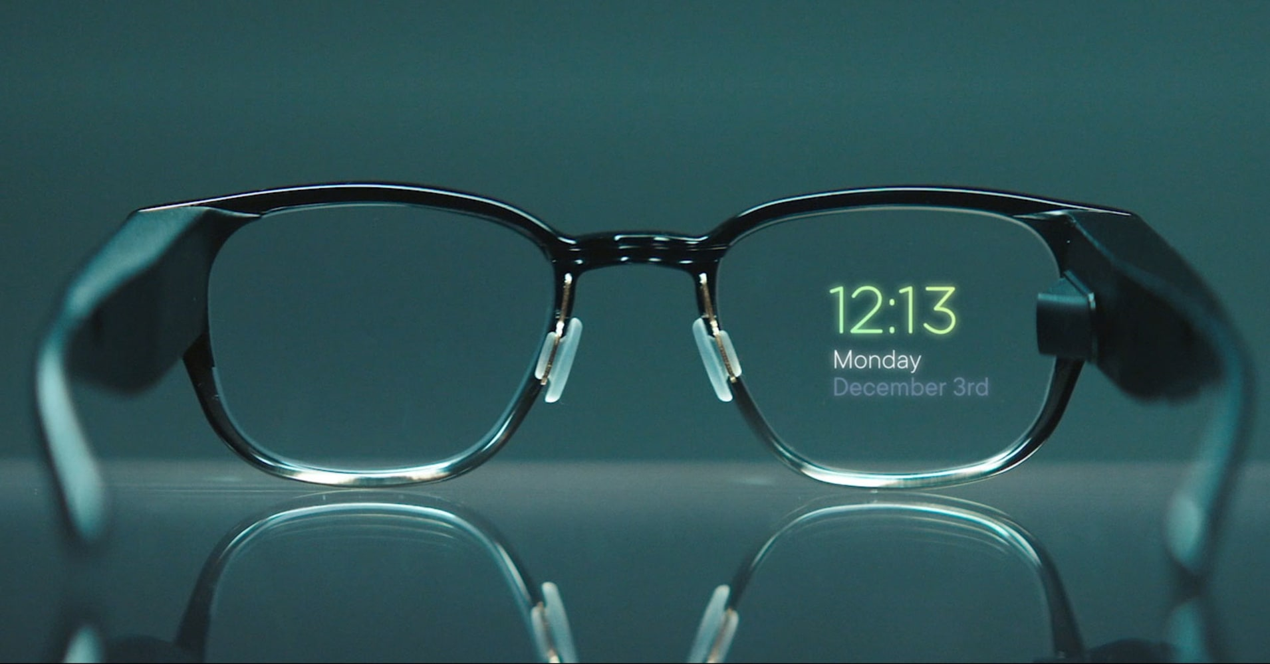
cARe
Augmented reality (AR)
Users include doctors, nurses, EMTs
Interact with hand gestures
“Using AR with cARe!”
Notes:
“CARE, is an augmented reality (AR) application designed for AR equipped glasses to visually show a patient’s relevant medical information to tending healthcare professionals. These healthcare professionals include doctors, nurses, EMTs, and any other healthcare worker who needs to see a patient’s information quickly and hands-free.
Users would interact with the system through specific hand movements such as swiping through X-rays as if interacting with a tablet or dragging a patient’s name to the center of the screen to see a more detailed readout of their information.
We expect our product to be used in various settings such as in hospitals, by paramedics responding to 911 calls, medical offices, and anywhere healthcare workers are needed.
“To check out our lofi demo I’m going to pass this off to Gaby!”

Slide 3
EMBED VIDEO
Notes:
*Play demo video*

Slide 4
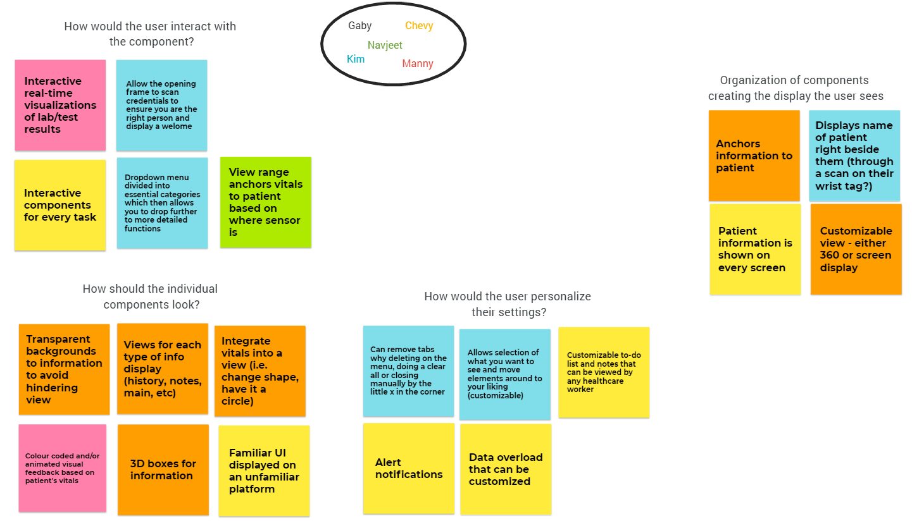
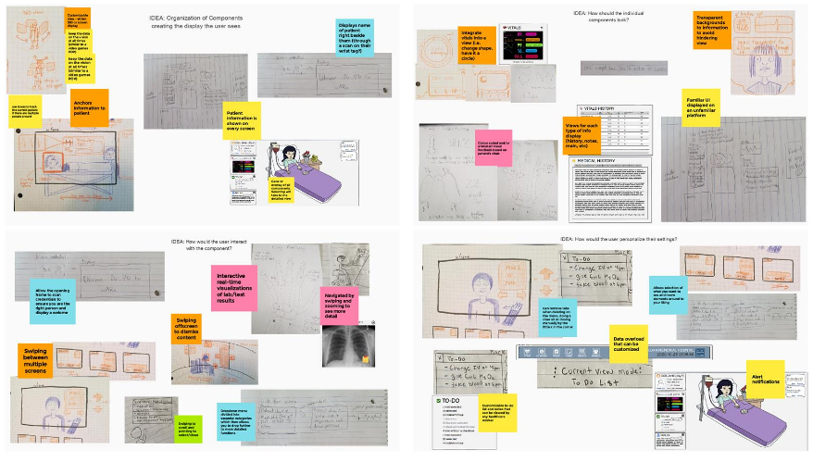
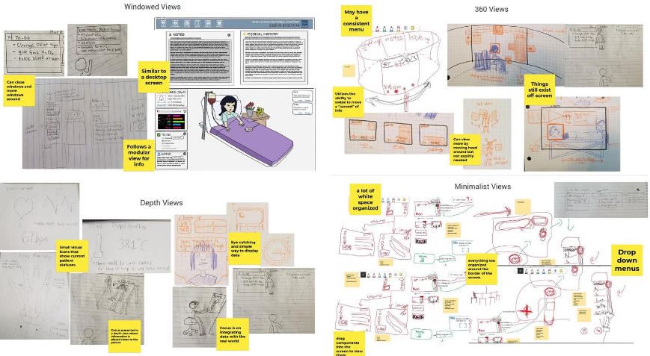
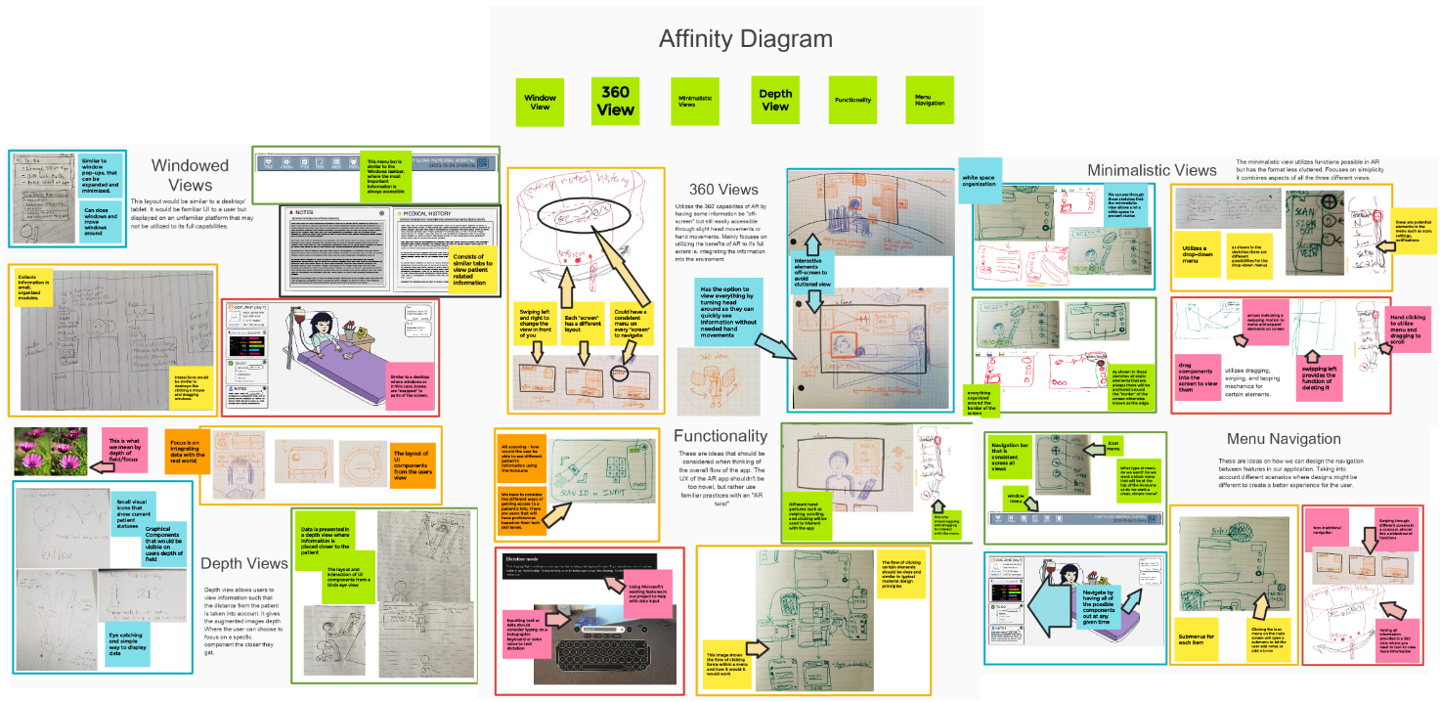
Affinity Diagrams
Iteration 1
Iteration 2
Iteration 3
Iteration 4
Notes:
Thanks gabi
This is our affinity diagrams. As you can see on screen we had to go through many iterations of formatting and organizing to get to our final iteration. While this took up a large amount of our initial time, the practice of constantly reviewing and reorganizing our ideas helped us gain a strong handle on what we really want to include in our design.

Slide 5
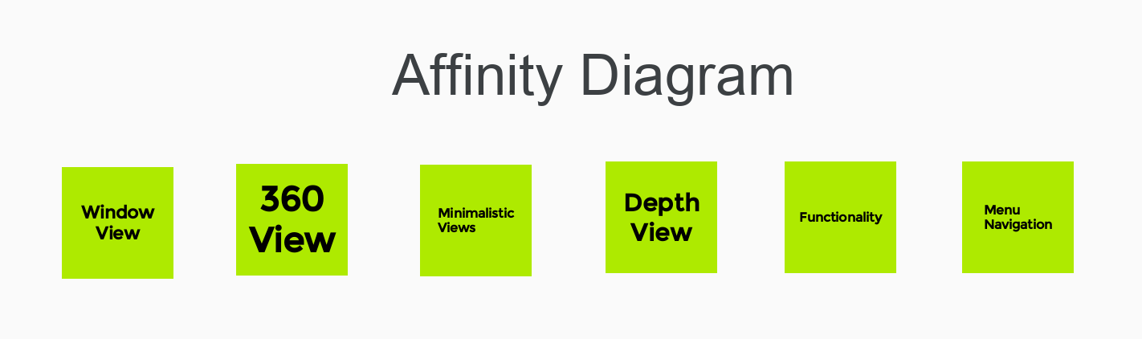
Final Affinity Diagram
Views
Windowed View
360 View
Minimalistic View
Depth View
Functionality
Menu Navigation
Notes:
On this slide is our final affinity diagram however we have separated the diagram into separate slides because we used our sketches within our groups therefore we decided it would be better to split it into multiple slides visibility purposes. We have 3 groups they consist of views, functionality and menu navigation. Under Views we have 4 different sub groups which are windowed view, 360 View, minimalistic view, and depth view.

Slide 6
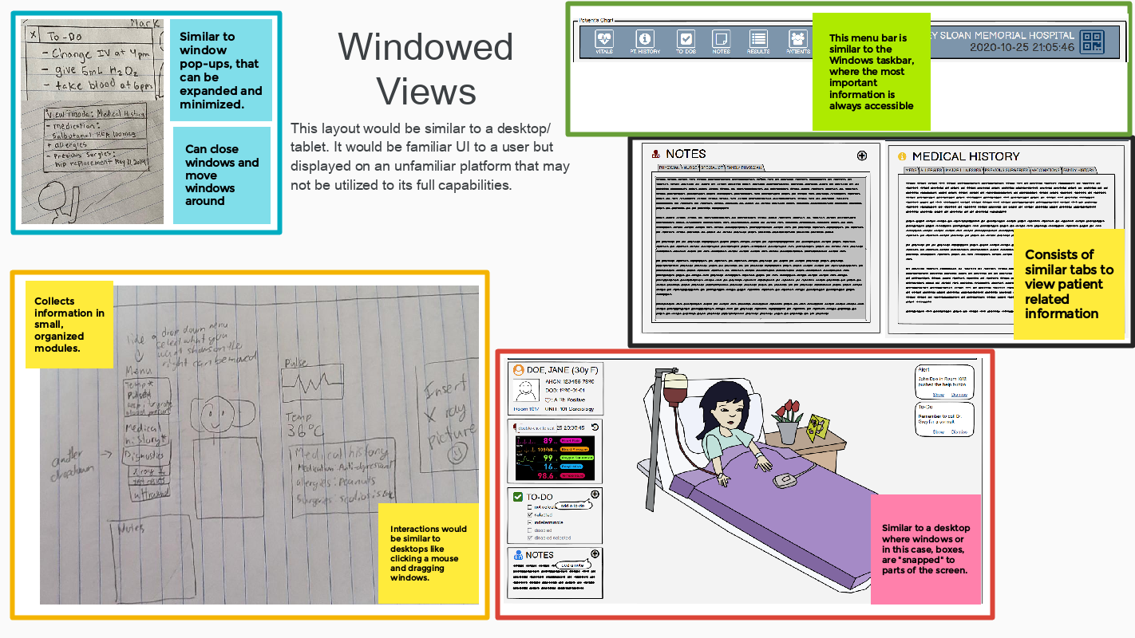
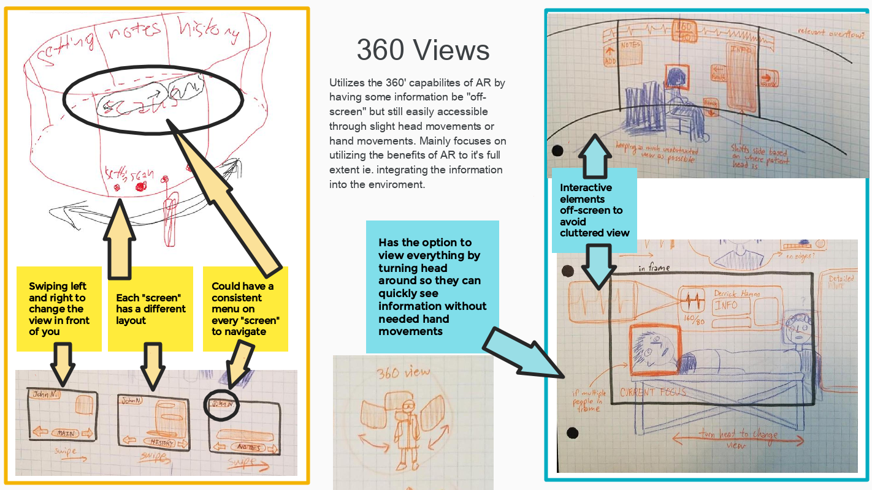
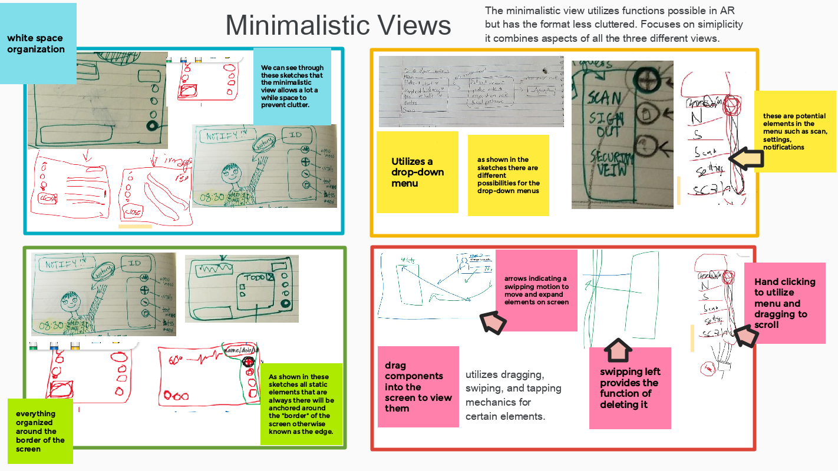
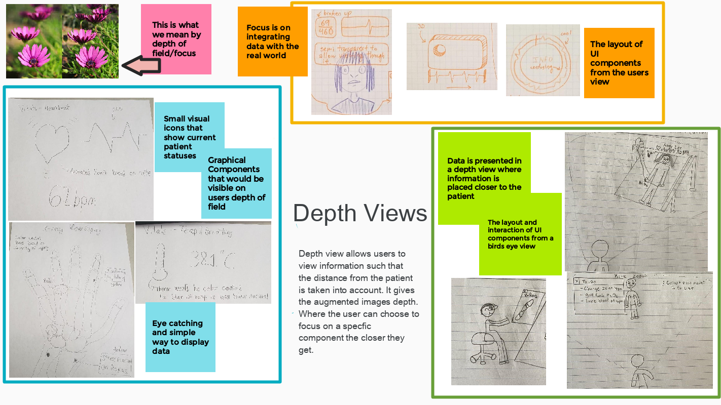
Final Affinity Diagram
Notes:
First, we have our windowed view, this group focuses on the layout that is similar to a desktop or tablet. The second is 360 view this was created based on the futuristic sketches that allowed users to see something all around them when using the system. Minimalistic View is based on the idea of keeping the UI very simple, clean and less cluttered. Lastly depth views was focused on having all elements anchored to the patients.

Slide 7
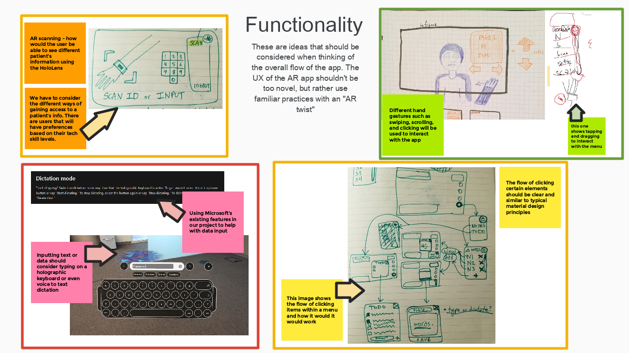
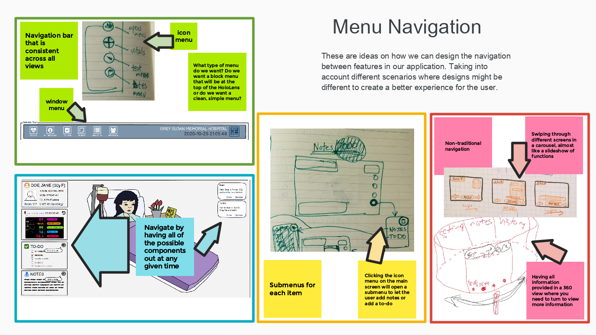
Final Affinity Diagram
Notes:
Next we have our functionality group, this group focuses on different functionalities such as hand gestures, and the flow of the system. Finally we have menu navigation which was a group the contained all the different possible ways we can have users navigate through a menu. This included submenus, blocks of menus, icons and words.

Slide 8
Removed Ideas
Windowed View
Depth View
360 View
Notes:
After finishing our affinity diagram the ideas we decided to remove were windowed view, depth view, and 360 view. We removed windowed view because we found it to be the least original and it did not utilize any of the AR capabilities. We removed depth view because though it had many interesting elements we were worried that it may cause an annoyance to users having everything anchored to the patient. Lastly, we removed 360 view because though it was the most unique we believed that it was not practical in a real world scenario and the gesture of scrolling through slides may look unprofessional.
Now we will have Navjeet continue with the next portion of our presentation.

Slide 9
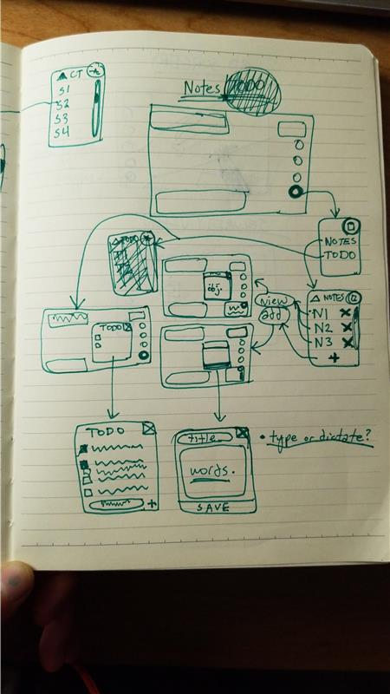
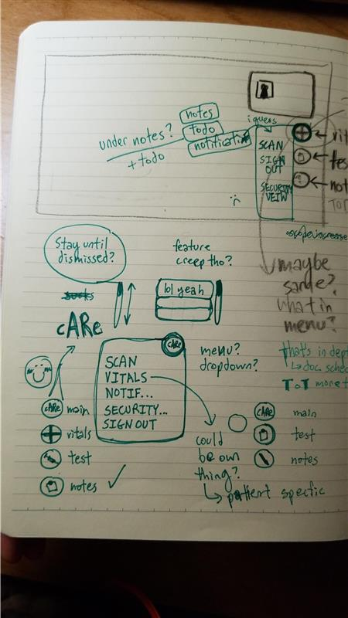
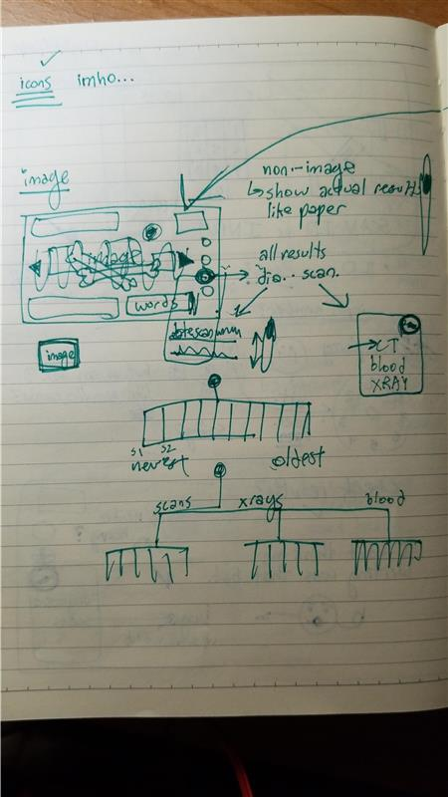
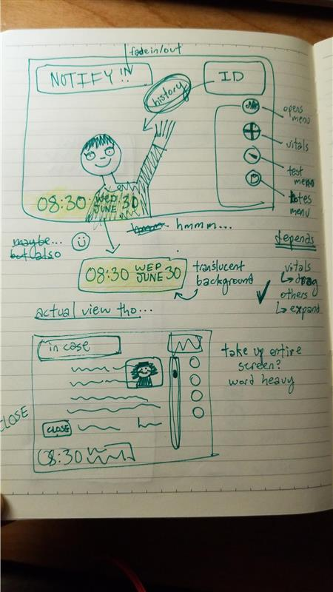
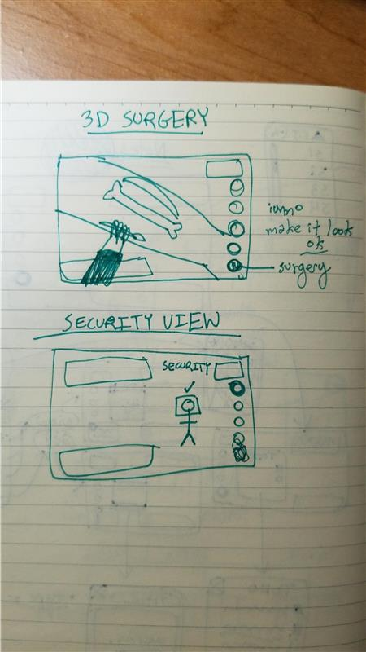
Final Idea Refinement
Meeting up as a group for a couple of hours and running through ideas as a team
Notes:
Navjeets speech for slide 10 and 11: Thanks Kim. We took all of our brainstorming and started to refine all of our ideas, which surprisingly took us a couple of hours. During the meeting we drew out how we wanted our prototypes to look like, while considering the UI and UX experience. It was at this stage we realized scanning the patients face would not be feasible but a wrist band that has a barcode was more practical. In our discussions our main focus was to have a consistent design while maintaining the smooth flow from one task to another. Which in turn helped us design this storyboard.
Let me walk you through it. In our first panel, a doctor receives word of a patient that has a severe arm fracture. The doctor then goes to the patient, turns on her AR glasses, and scans her personal ID which welcomes her. As the doctor scans the patients wrist band she starts to see the patients information appear and notices that the patient has a recent X-ray. Which she then views and makes it bigger with her hands to get a better reading. Once analyzed she closes the X-ray and pings the nurse to take it from there. Now let’s pass it on to Manny!

Slide 10
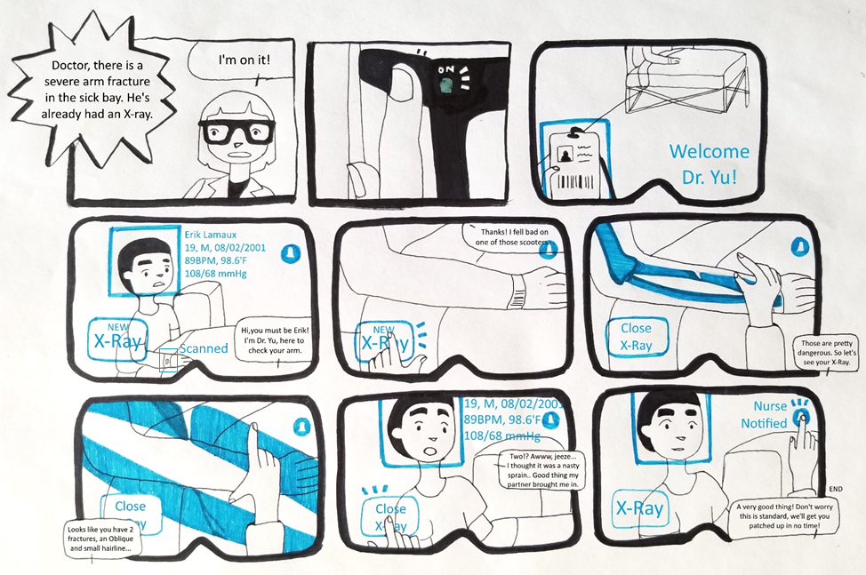

Slide 11
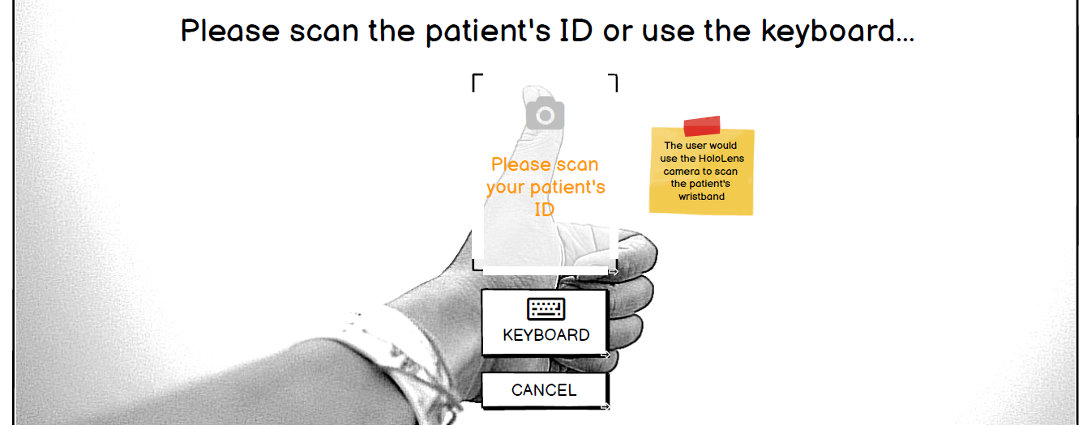
Lessons Learned Low-fi Prototyping
Bringing a blend of ideas to life
Improved component organization
Attention to detail is king
Notes:
Alright thank you Navjeet!
During our lo-fi prototyping process we were able to learn some very valuable lessons. Number one would be that prototyping was beneficial in bringing our blend of abstract ideas come to life in the form of a visible product. It gave us an idea of which functions would be feasible for our product and which were too futuristic.
Number two we learned to better organize the components of our interface so that we can remove the tediousness of changing the location of a certain component. Like the placement of our notifications.
Lastly we all probably experienced frustrations while linking our frames as the scope of our prototype grew. So having the ability to maintain a close attention to detail really facilitated the creation of our prototype.

Slide 12
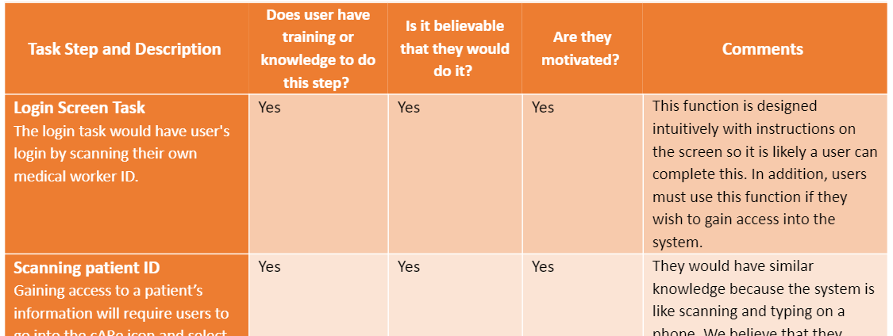
Cognitive Walk-Through Evaluation
Additional functionality
Flow of tasks changed
Allowed us to prune our task-load
Notes:
While discussing as a group were able to observe the changes we made from previous steps. We added some functionality to our system such as clearing patient data from the screen. We also noticed how the flow of some of our tasks changed from the beginning since we assume our users have little to no experience using AR glasses.
So overall our cognitive walkthrough evaluation was a beneficial stage of our ideation process as it allowed us to see which tasks fit within our use cases and which tasks were not feasible to implement in our reality since on their own they could potentially become their own different project.
Thank you so much for listening to our presentation and we hope you got some value out of it! If you have any questions please feel free to add a comment under our discussion post in the teams channel and we would love to discuss it further with you.

